Slide 1
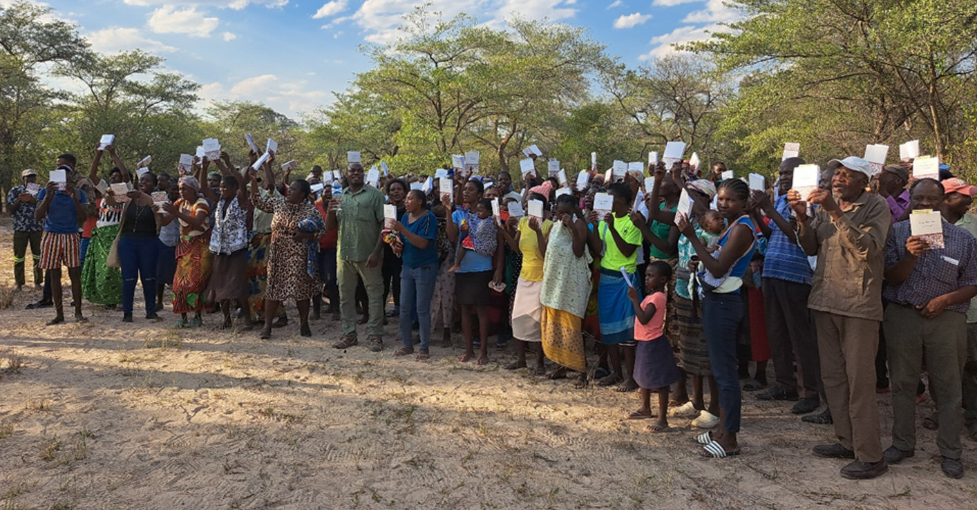
Community Acceptance and Accessibility
Notes:
02/07/2024

Slide 2
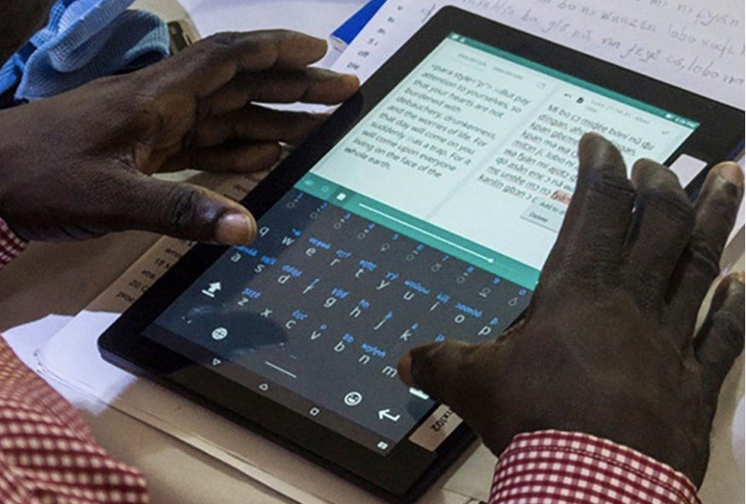
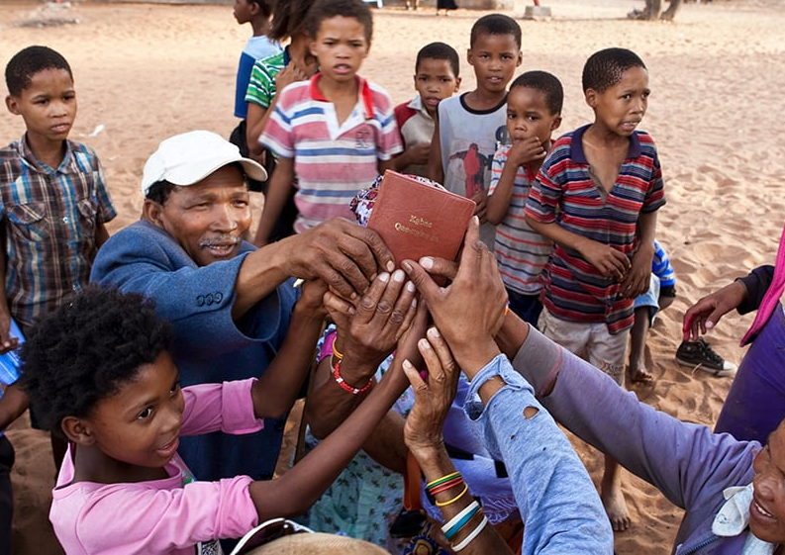
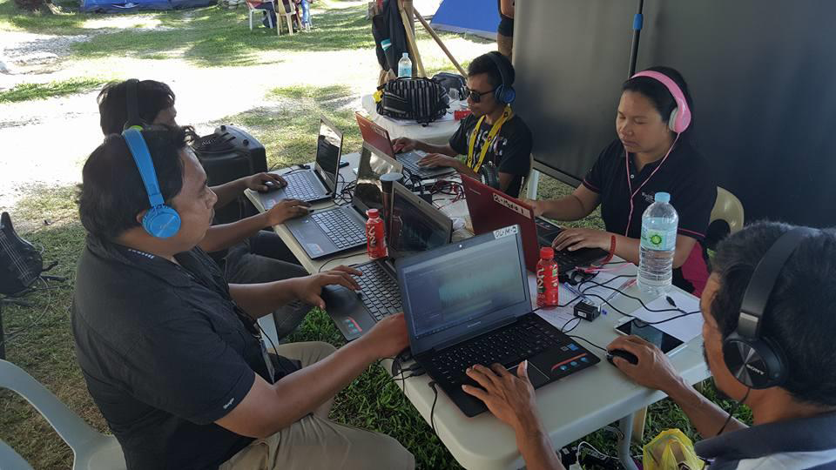

1 Corinthians 9:22
What expectations does your community have for sacred material?
Have you considered whom the community would accept as translators and participants?

Slide 3
Use the white board to record characteristics
What characteristics are expected? What would be accepted?
1 Thessalonians 2:13
Format
Printing & paper
Cover

Slide 4
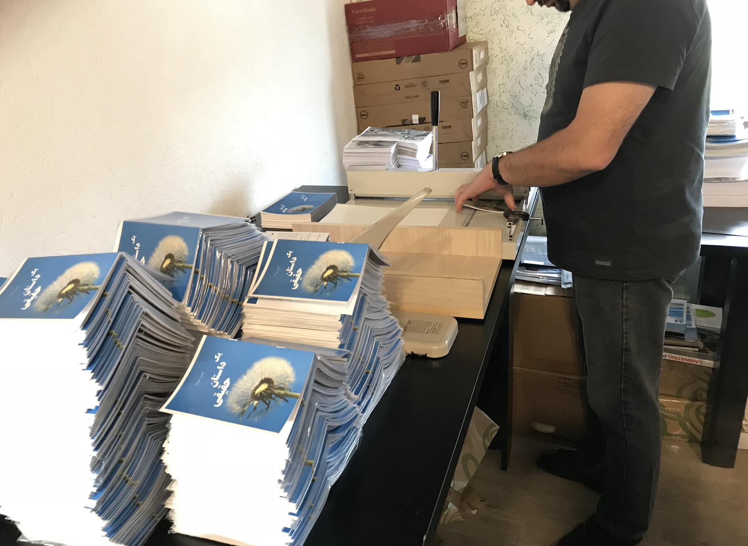
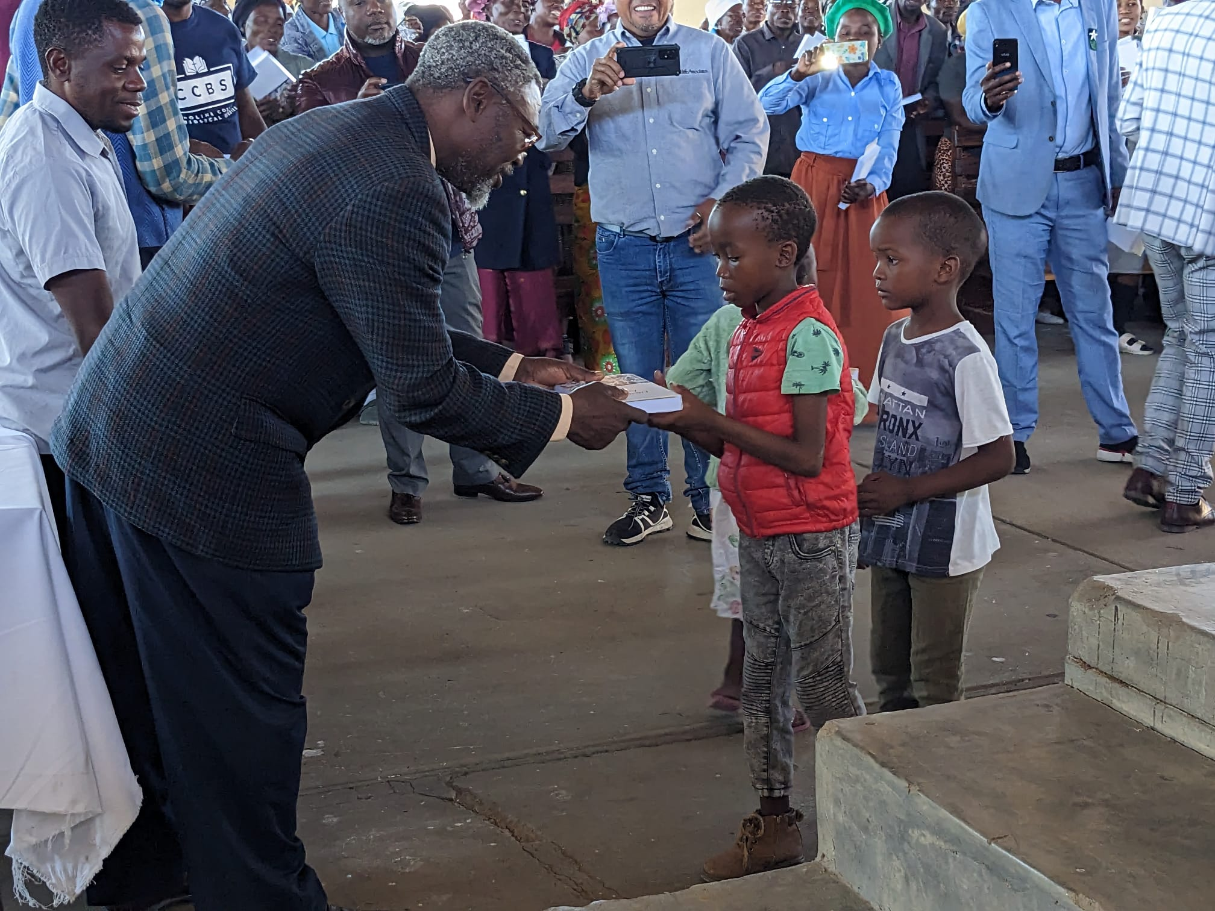
How is Accessibility different from Acceptability?

Slide 5
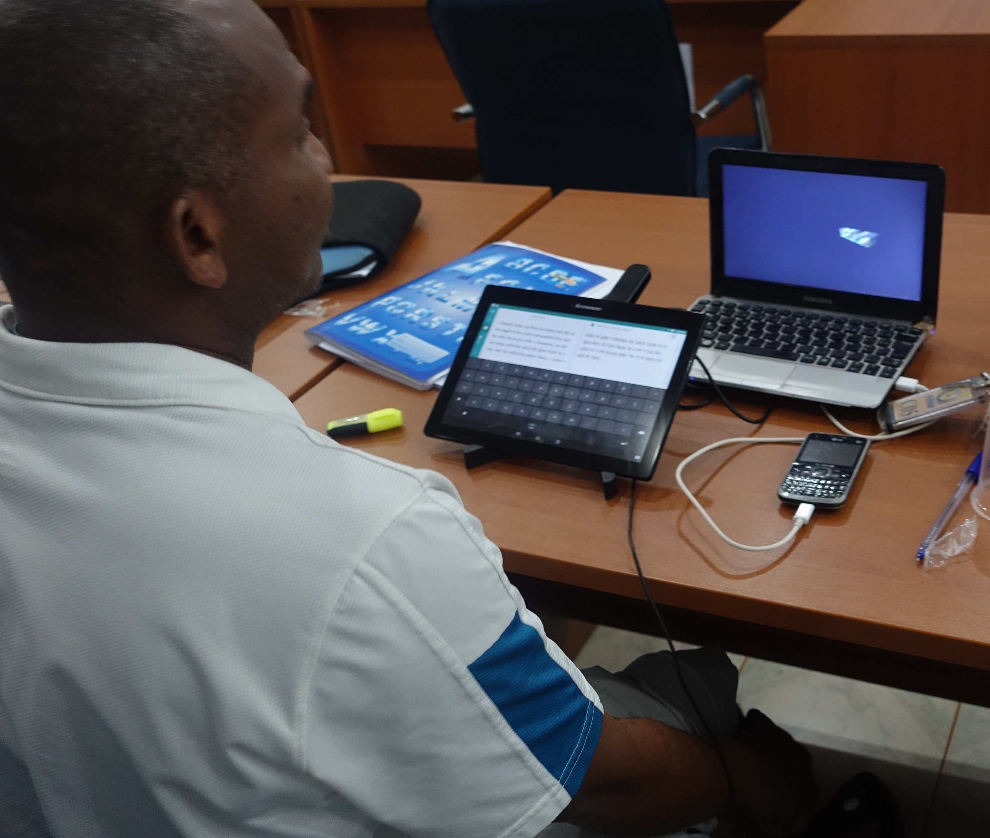
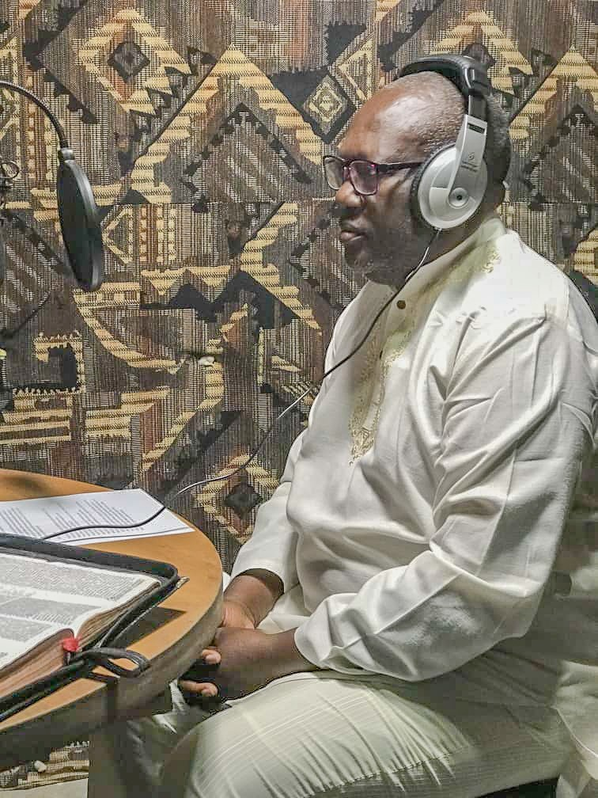
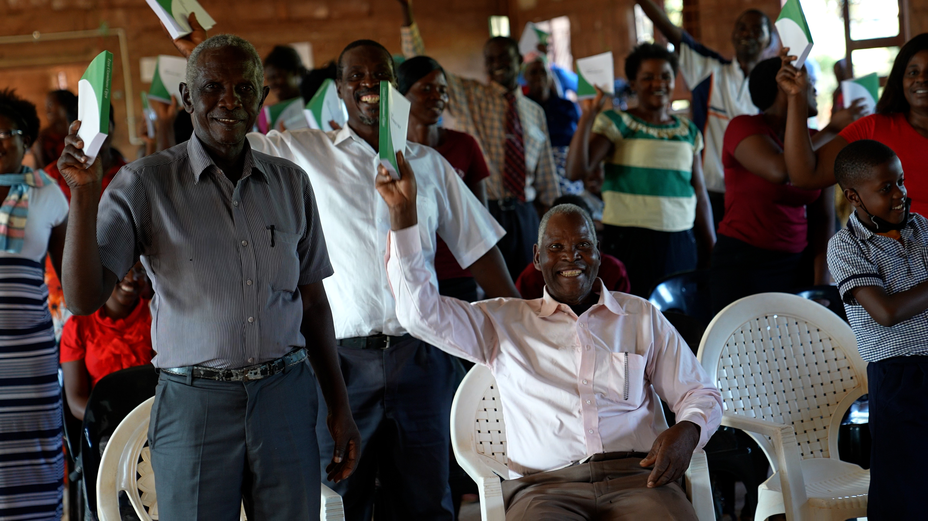
How will Scripture be made available?

Slide 6
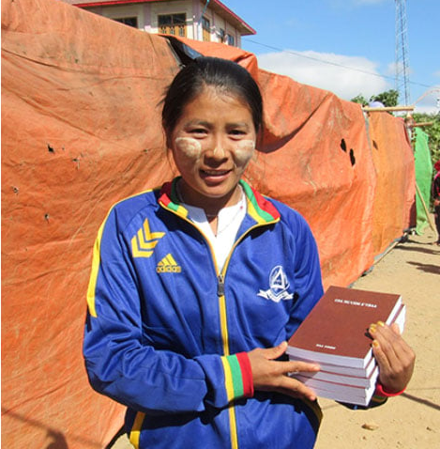
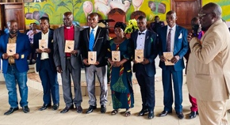
Have you talked to the community about this?

Slide 7
?
Have you chosen the type of translation?
Printed
Read online
Audio

Slide 8
Think things through together.
Discuss questions for your type of translation.
Notes:
02/01/2024

Slide 9
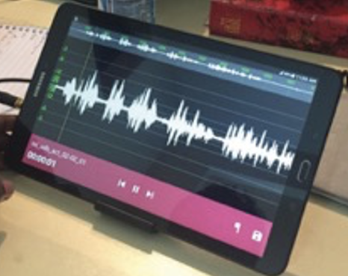
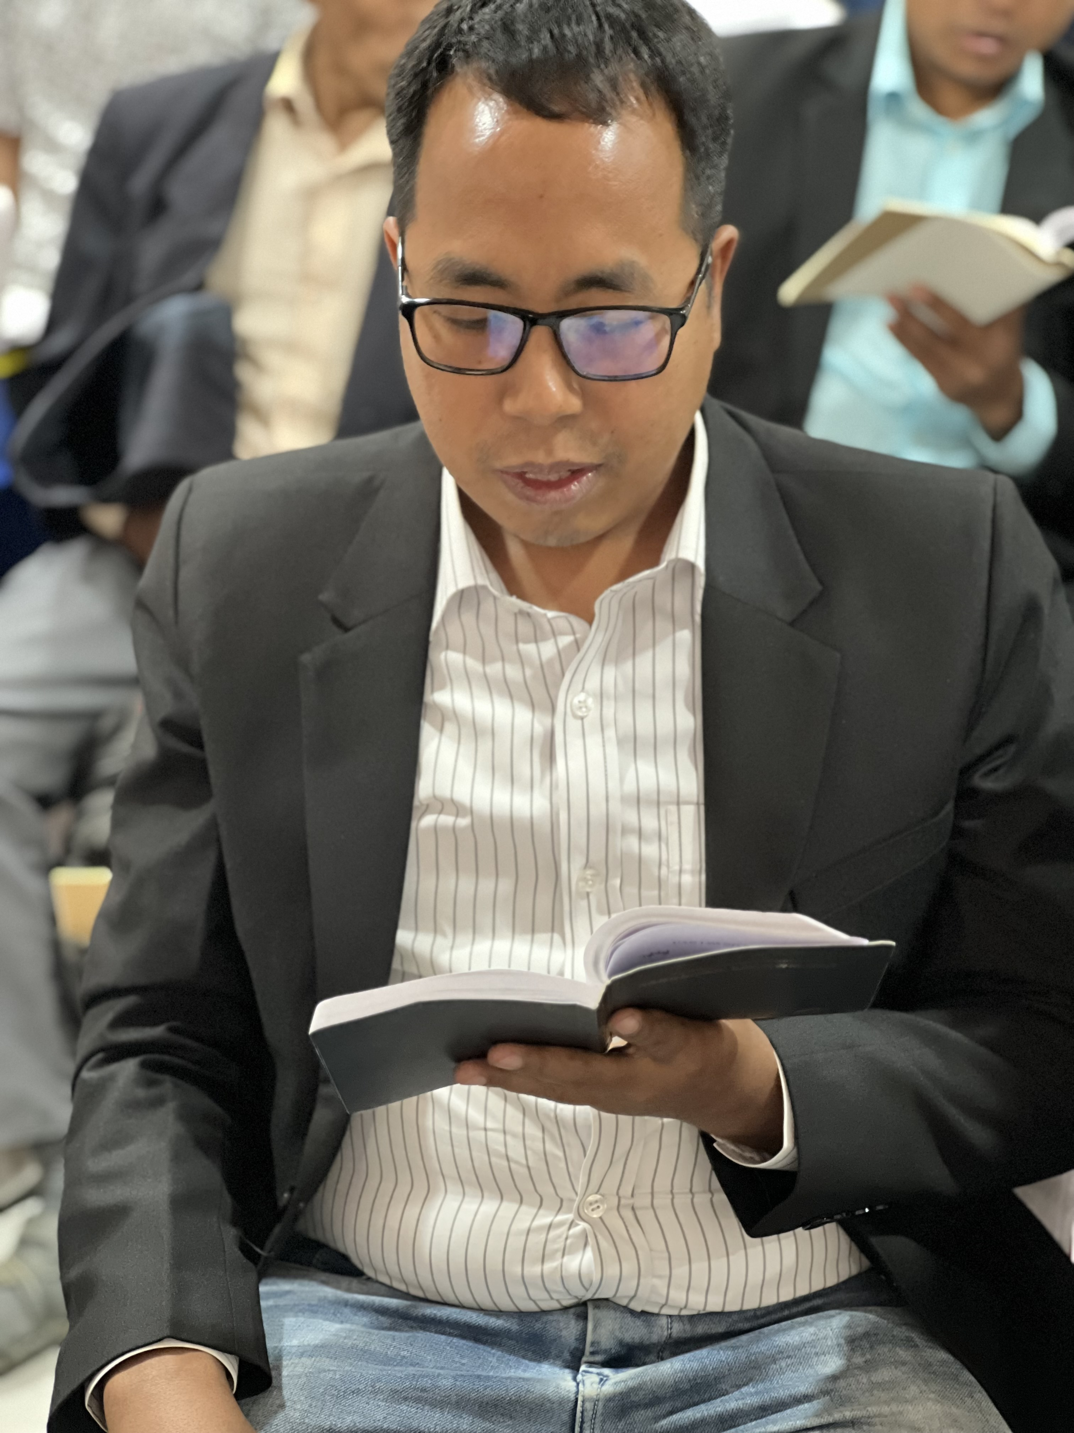
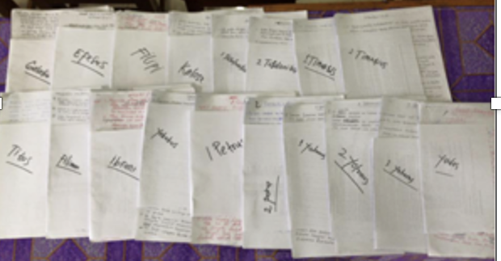


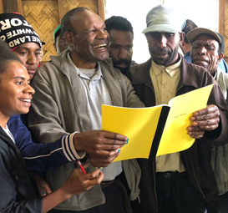
Difficulties with technology?
Wycliffe Associates Technology Advance can help!

Slide 10


